Slide 1


A year in review October 2024 – October 2025

Slide 2


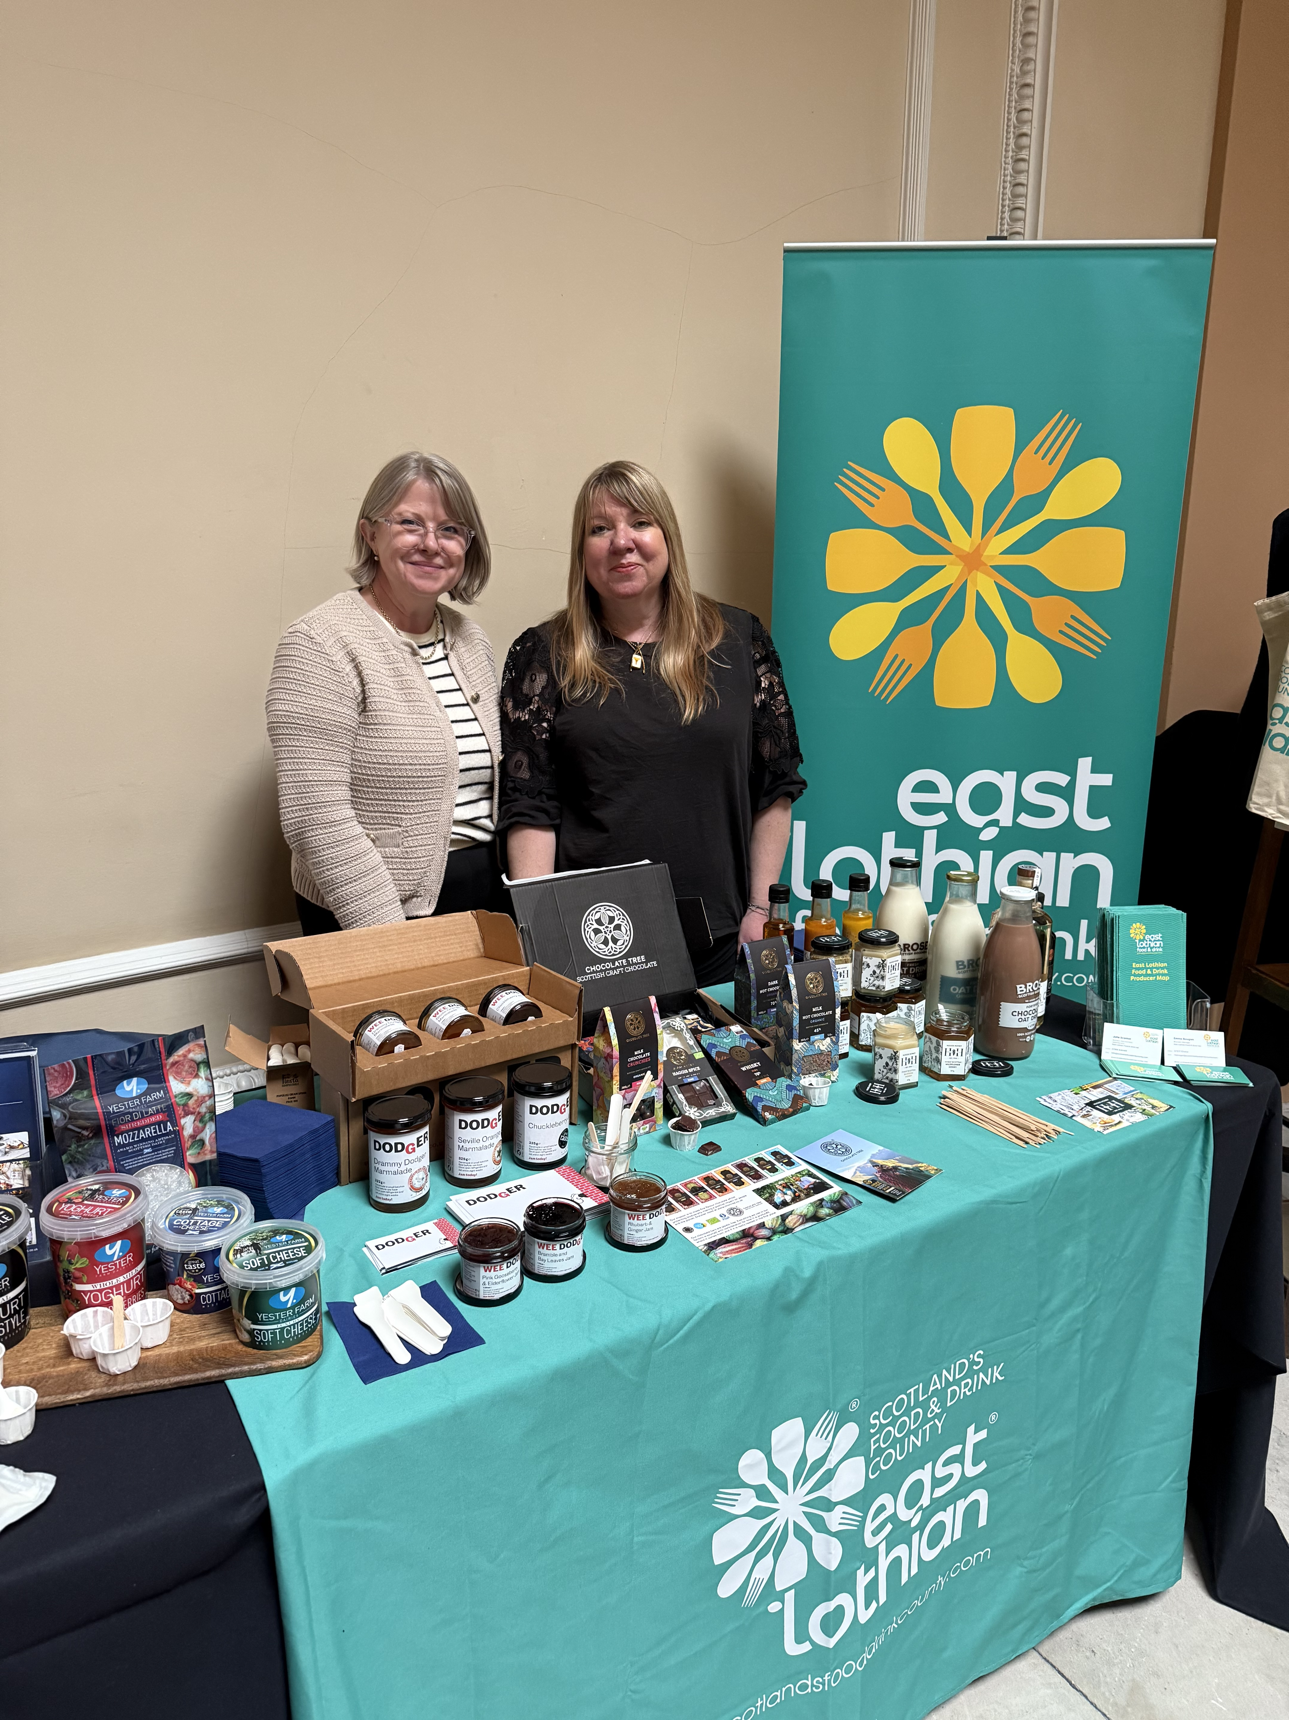

Events in 2025

Slide 3
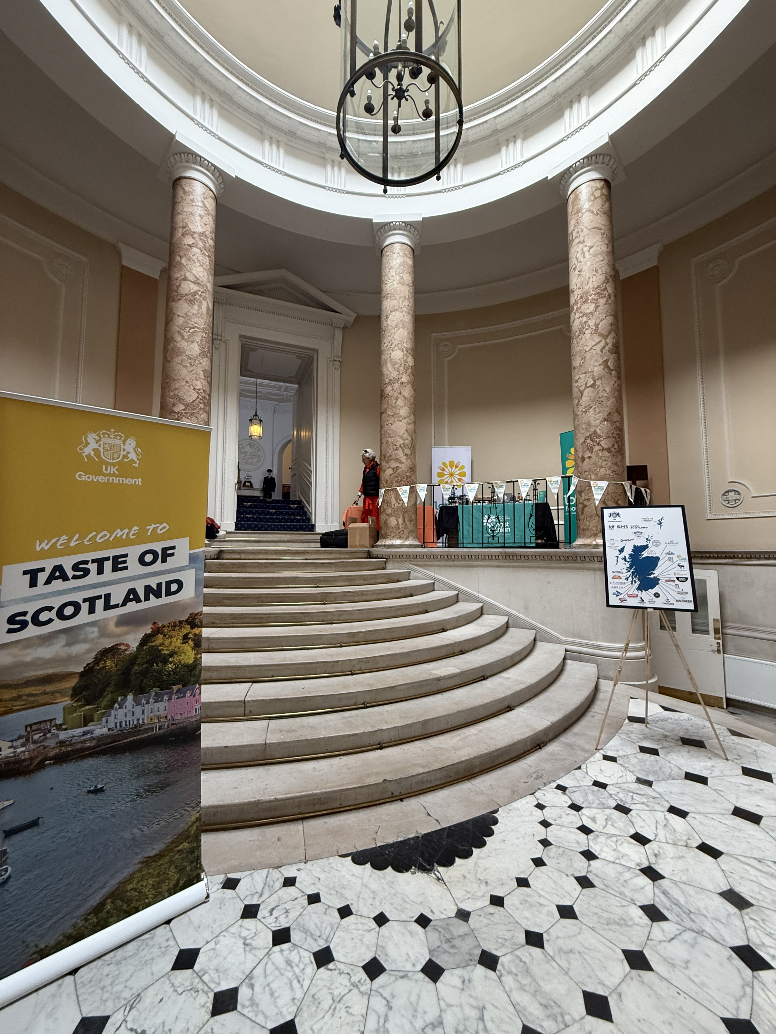
Taste of Scotland
Dover House
January 2025

Slide 4
Scothot
February 2025

Slide 5
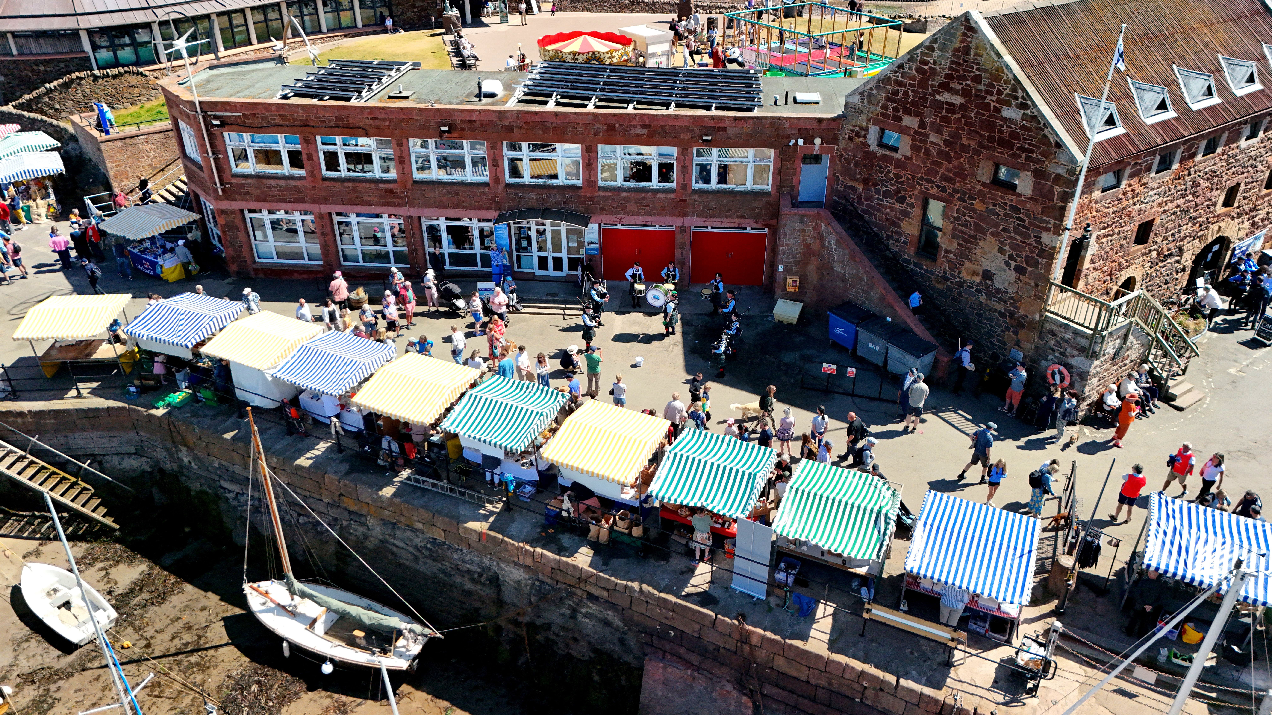
The monthly North Berwick Harbour Market
May - December 2025

Slide 6


Royal Highland Show
June 2025

Slide 7
Haddington Agricultural Show
June 2025

Slide 8

East Lothian Land, Sea & Hills
Recipe Book

Slide 9
Other Benefits
2025
February – Personal License and Food Hygiene Training
February – Company Bakery Members gathering
ELC Offered SALSA accreditation to members
November – East Lothian Recipe Book Launch

Slide 10
Future Plans
2026
November 2025 – Intention to go to re ballot has been lodged with ELC and SIDs Scotland
November 27th – MP Kirsty McNeill reception at Queen Elizabeth House – ELFD to provide EL produce for the event.
December 12/13/14th – NB Harbour Christmas market Weekend sponsored by NB Trust
January 2026 – Personal License Training and Food hygiene Training – also advanced Food Hygiene will be offered at a subsidised rate.
June 2026 – Royal highland Show 2026 and Haddington Agricultural Show
August 2026 – Fringe by the Sea Recipe Book cooking demos
Ongoing in 2026 - BID Renewal – Ballot will take place in June 2026
Ongoing - The East Lothian Food and Drink Recipe Book will be sold in lots of outlets as well as local shops and on line.
Ongoing - further colloborations with other RFG’s
NB Harbour Market will commence again in April and Run again until December 2026

Slide 11
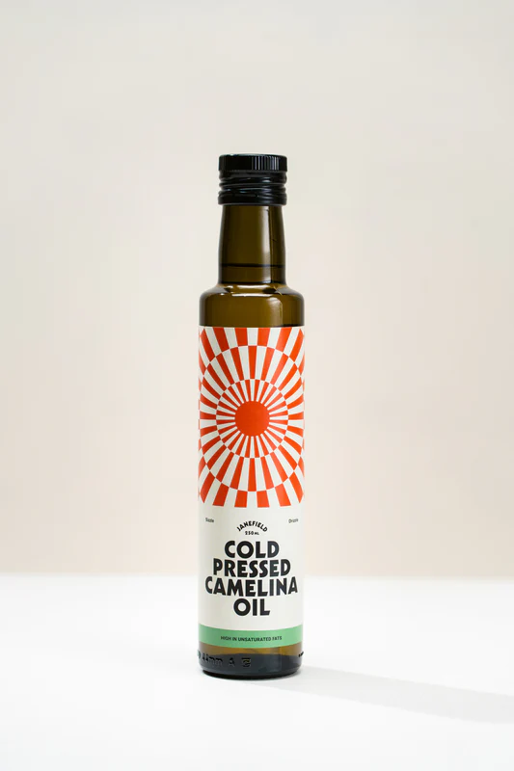
Introducing new members Janefield Farm

Slide 12
Introducing new Supporter members!
Fenton Tower
Provenate
Archerfield Walled garden

Slide 13
Funding 2025-2026
Fund | Who | When | £
Regional Food Group Coordinator Funding | Scotland Food & Drink | April 2025 | £12,600
Core Funding | East Lothian Council | August 2025 | £25,000
NB Trust Community Fund | NB Trust | November 2025 | £3,840
Market Income for 6 moths |  | May-December 2025 | £6,500

Slide 14


Social Media Stats
October 24 to October 25
Oct 24
2. 316 followers
Oct 25
2.869 followers
Oct 2024
2,916 Followers
Oct 25
3,056 followers

